Slide 1
Dispatcher servlet
( similar to ActionServlet of struts)
Handler Mapping
MVC controller
(similar to Action of struts)
View resolver
View ( JSP )

Slide 2
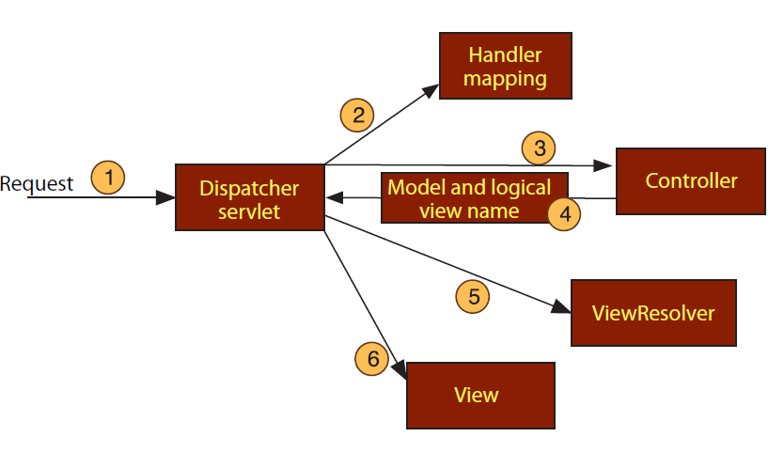

Slide 3
Spring MVC Flow

